Slide 1

PARTYCAST

Slide 2



,Y
PARTYCAST
+
=
2-4

Slide 3
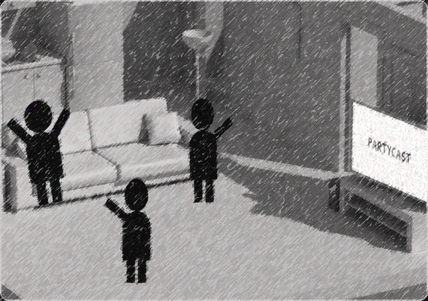
,Y
PARTYCAST

Slide 4


,Y
PARTYCAST

Slide 5

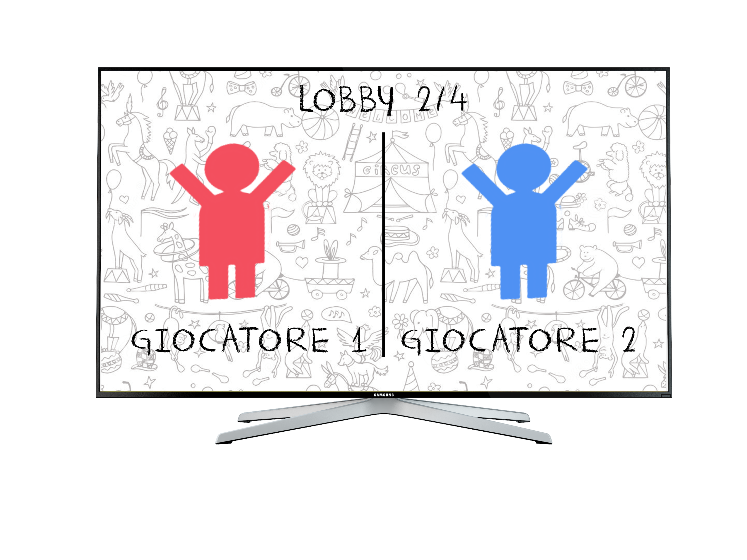
,Y
PARTYCAST

Slide 6
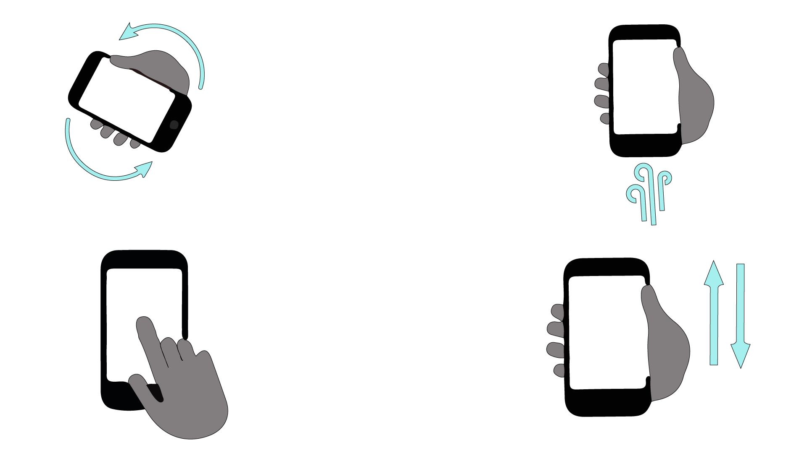
,Y
PARTYCAST

